Slide 1
Activities for contextualizing Mathematics in Undergraduate Courses
Dawn Archey
January 5, 2017
JMM-Atlanta, GA
Project NExT

Slide 2
Time to Multi task
Solve these two problems.
Jot down any feelings and non mathematical thoughts you have

Slide 3
Problem 1
There are 4 million bacteria on a peach at noon on Tuesday. Assume a bacterium divides into two bacteria every hour, on average. Let f(t) be the number of bacteria (in millions) on the peach at t hours after Tuesday noon.[LEH]
Find an equation of f.
How many hours will it take for there to be $8×{10}^{9}$ bacteria on the peach? Give your answer in a complete sentence with units.

Slide 4
Problem 2
The function $f\left(x\right)= 4.5242ln(x) + 33.774$can be used to predict the life expectancy at birth $f(x)$ in a country where the GDP per capita is $x$ US dollars. (Data from [WRI] and [WHO])
Use the model above to predict the life expectancy at birth in a country where the GDP per capita is $40, 000.
North Korea does not publish the information which is usually used to determine GDP [CIA]. However, in North Korea, life expectancy at birth is 63.8 years[CL]. According to the model, what is the likely GDP per capita of North Korea?

Slide 5
Story Problems vs AAPs
Billy and Suzie are building a snowman. After 5 minutes of work they have a snowball with diameter 12 inches. Two minutes later, the snowball has diameter 16 inches. What % has the volume changed?
Answer the question posed in @MathInTheNews 's tweet from July 14, 2015:
New Horizons says Pluto's diameter is 1473mi, 50mi larger than believed. What % does that change its volume estimate?
zzzzz!

Slide 6
Story Problems | AAPs
Toy Scenario | Realistic Scenario
No one wants to know the answer | Scientists or politicians or homeowners want to know the answer
Uses material from the section | Uses material from the section and other material
May be an easier way to obtain the answer (ex measure directly) | Hard/impossible to find answer without doing math
 | Ideally, only about 10% harder
zzzzz!

Slide 7
Why give AAPs
Students hate story problems but want to know “when will I ever use this?”
Employers want these skills (and when you tell students that it motivates them).
Doing authentic problems also improves skill in rote problems [BOA]
Fun for you
For new faculty-its an innovation you can do whenever you have time, no big upfront commitment.

Slide 8
Cautions about AAPs
Students get frustrated, but are satisfied afterward.
Can take a long time to make (1-4 hours for one worksheet problem)
Making them can be addictive
If you want to make a problem about a certain type of function, say quadratic its hard to find data that has the right shape.
Don’t forget to cite your sources—set a good example.

Slide 9
References
[AMSA] http://www.amsa.gov.au/Marine_Environment_Protection/Educational_resources_and_information/Teachers/Classroom_Projects/Mathematics_and_Oil_Spills.asp
[BOA] Boaler, J. ``Open and closed mathematics: Student experiences and understandings.'' Journal for Research in Mathematics Education, 29 (1998), p 41-62.
[CIA] https://www.cia.gov/library/publications/the-world-factbook/geos/kn.html accessed 12/2/2014
[CL] Ben Crow and Suresh K. Lodha The Atlas of Global Inequalities. 2011.
[LEH] Lehmann, J. Intermediate Algebra, 5th ed.
[NBC] http://www.nbcnews.com/id/37717335/\#slice-2
[TIME] http://www.time.com/time/interactive/0,31813,2006455,00.html
[WHO] http://apps.who.int/gho/data/node.main.688?lang=en accessed 12/2/2014
[WIKI] http://en.wikipedia.org/wiki/Deepwater_Horizon_oil_spill
[WRI] http://www.wri.org/resources/data-sets/cait-country-greenhouse-gas-emissions-data accessed on 12/2/2014

Slide 10
Example AAP
On April 20, 2010 the Deepwater Horizon drilling rig exploded initiating the worst oil spill in US history. It was important to estimate the volume of oil spewing out each day, but it is hard to measure such high volume flow directly. Suppose that the spilled oil is cylindrical in shape and a uniform thickness of 1mm [AMSA]. On day 9 of the spill the area of the spill was 13,000 km2 [TIME] and the radius of the spill was increasing at a rate of 743 meters per day [NBC].
At what rate was the volume of the spill increasing on the 9th day?
How quickly was the oil spewing out on the 9th day?
BP's official estimates of the flow rate were 160 to 790 m³/day [WIKI], how accurate were their estimates?

Slide 11
AAPs can be very simple
This appeared on my Facebook wall. What does it say? What's the point?

Slide 12
Sources of AAPs and other good problems
My blog: http://blogs.udmercy.edu/archeyde/
Mathematics and Social Justice: Perspectives and Resources for the College Classroom. (Eds. Karaali, Gizem and Khadjavi, Lily) to appear from MAA press.
Nasa http://www.nasa.gov/audience/foreducators/index.html
Thomas Pffaf’s http://www.sustainabilitymath.org/index.html
USE Math http://usemathanywhere.myfreesites.net/activities
SISL http://serc.carleton.edu/sisl/2012workshop/activities.html

Slide 13
Where to find ideas for AAPs
News
Social media
Adjust text book problems
Data sets or graphs
Articles on things that interest you
Non fiction books
Talk to people in
other fields

Slide 14
How to make an AAP-method 1
Find some mathematics lurking in something
Write a problem that makes your students see it too.
Don’t forget to cite your sources.

Slide 15
Example-lurking Logarithm

Slide 16
How to make an AAP-method 2
Get a hold of some interesting data.
Graph the data and fit a curve to it.
Hope the curve is the right “type” of function for the unit you are on.
Write a problem using the function.
Don’t forget to cite your sources.

Slide 17
Example- Data and Curve

Slide 18
You try it.
Street Sign in Washington, DC.

Slide 19
You try it.
http://www.slate.com/blogs/bad_astronomy/2015/09/03/ice_loss_greenland_and_antarctica_lost_5_trillion_tons_since_1992.html

Slide 20
You try it.
Inverse function This is how I will always explain inverse functions from now on. brilliant!
https://scontent-ort2-1.xx.fbcdn.net/v/t1.0-9/13620759_523233831199670_3158018571010022761_n.jpg?oh=f34d9951245a51f846d26f7bd6adff63&oe=58E49309

Slide 21
You Try it
http://blog.plot.ly/post/120532468127/how-to-analyze-data-seven-modern-remakes-of-the

Slide 22
You try it.
xkcd.com/539/

Slide 23
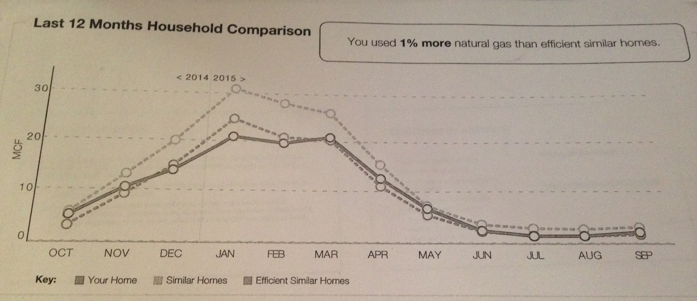
You try it.
My gas bill

Slide 24
Where to publish AAPs
I don’t know, suggestions welcome
I got two in as book chapters
I put mine on my blog http://blogs.udmercy.edu/archeyde/
I’m thinking about writing/editing a book, if you’d like to contribute let me know

Slide 25
Questions or answers
Where can I publish AAPs?
Where can I find AAPs?
Do you want to contribute to my book of AAPs?
Any suggestions for AAPs on?
Graph Transformations
Trig graphs
Parallel and perpendicular lines
Piecewise functions
Rational Functions
Radical Functions
My email address:
archeyde@ udmercy.edu
My blog:
sites.udmercy. edu/archeyde/

