Slide 1
Michigan Initiative for Maternal and Infant Oral Health
Subtitles
Grace Model for Pregnant Mothers
Muskegon Family Dental Coach Model
Authors
John Girdwood, MSA, PhD
Kevin Steely, DDS
Staci Hard, RDH
PUBLIC SESSION
9a: Welcome and Introductions of Key Partners
930a: Grace Health Model for Pregnant Mothers
10a: Tour of Grace Health
PROJECT PARTNER SESSION
1045a: Toolkit, Physical Plant, Armamentarium
Noon: Networking Lunch
1230p: Process and Workflow
130p: Dental Health Coach
2p: Coding, Billing, IT Support, and Data
230p: Research Project Calibration

Slide 2
9a: Welcome! Introduction of Key Partners
Presenters (Public Session 9a-1030a)
Mert Aksu, JD, MHSA, DDS, Dean, Detroit Mercy
Chris Farrell, RDH, BSDH, MPA, Oral Health Director; Dept. of Health & Human Services
Dan Thompson, COO; Michigan Primary Care Association
Peter Chang, MD, MPH, CEO; Grace Health
Doug Saylor, MD, Chief Medical Officer, Great Lakes Bay Women’s Care Bay City

Slide 3
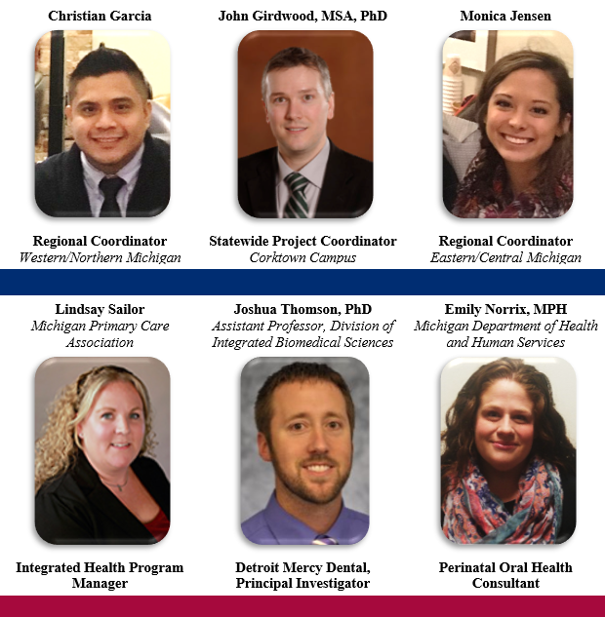
Project Team
John Girdwood: Strategy and Planning for Sustainability
Emily Norrix: Importance of Perinatal Oral Health
Lindsay Sailor: Integrating Oral Health Into Primary Care Clinics

Slide 4
6 Pilot Sites
East Region
Battle Creek
Bay City
Lansing
West Region
Muskegon
Benton Harbor
Upper Peninsula
East Region
West Region
https://upload.wikimedia.org/wikipedia/commons/0/0d/Map_of_Michigan_NA.png

Slide 5
Value Stream
2 Healthy Mouths!
New mother and baby
Pregnant mother visits OBGYN for prenatal care
Prenatal oral health care provided

Slide 6
Time for Questions

Slide 7
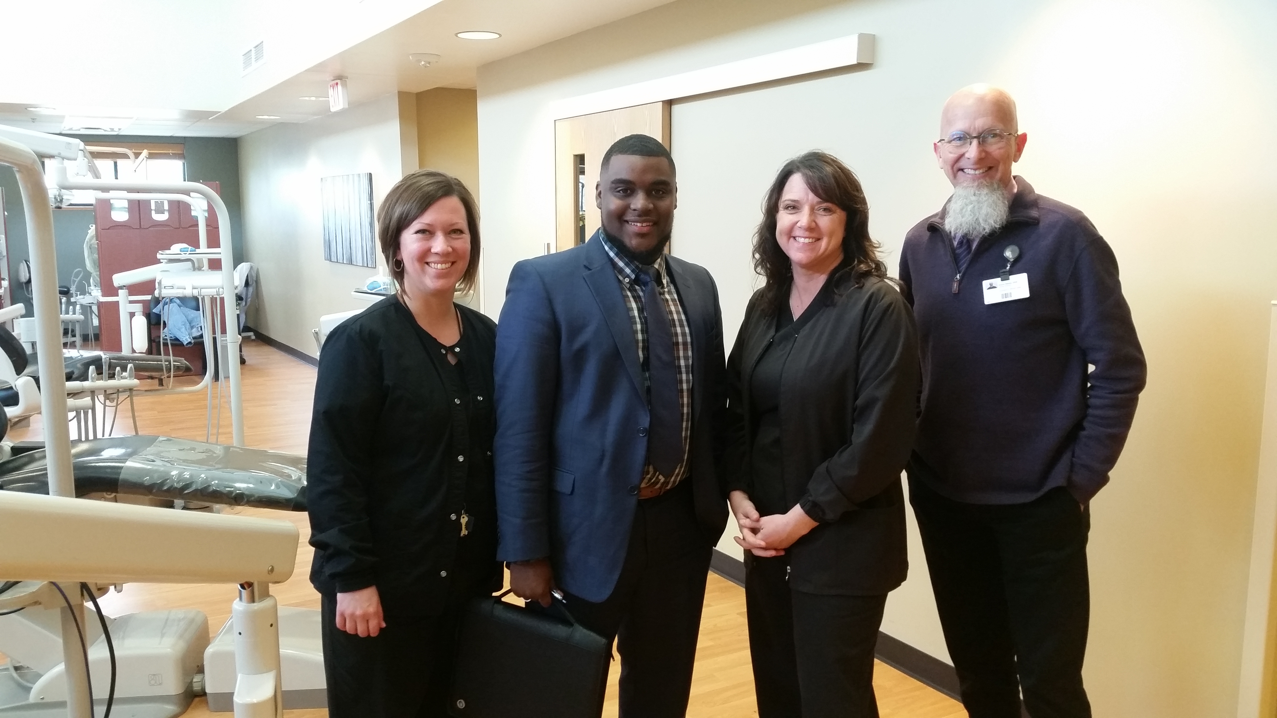
930a: Grace Model
Presenters
Kevin Steely, DDS
Staci Hard, RDH
Tracie Hurst, RDH
Alisha Morris, MBA
Staci, Derrick (Muskegon), Tracie, and Kevin

Slide 8
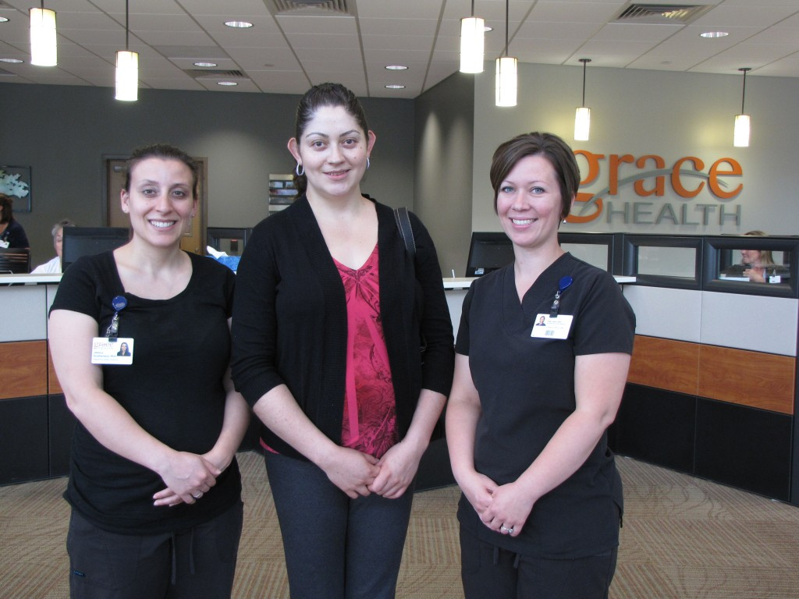
3+ Years of Patient-Centered Care
Launched 7/14/2014
Blue Cross Blue Shield of Michigan initial funding
1 of 5 pilot programs
1st Year ≈ 300 women served
First patients to complete: Rosa Cecilia Lara-Rives and son Arturo
Photo: (left to right) Jessica Southerland, RDH; Rosa Cecilia Lara-Rives and Staci Hard, RDH
http://www.gracehealthmi.org/uncategorized/1st-patient-complete-oral-health-program/

Slide 9
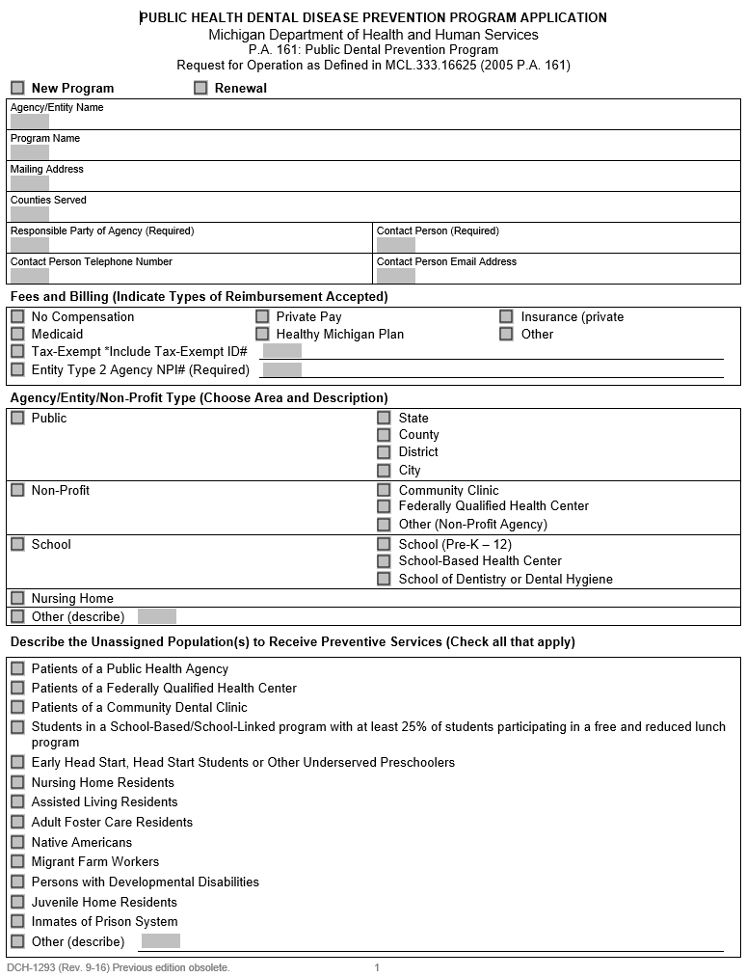
Getting Started
PREPARE THE PROJECT TEAM
Hire the best hygienist!
Interacts with OBGYN staff
Advocates for patients
Team requirements:
Motivated
Passionate
Flexible
Operations must dedicate space for the hygienist
Complete the DCH-1293 Application

Slide 10
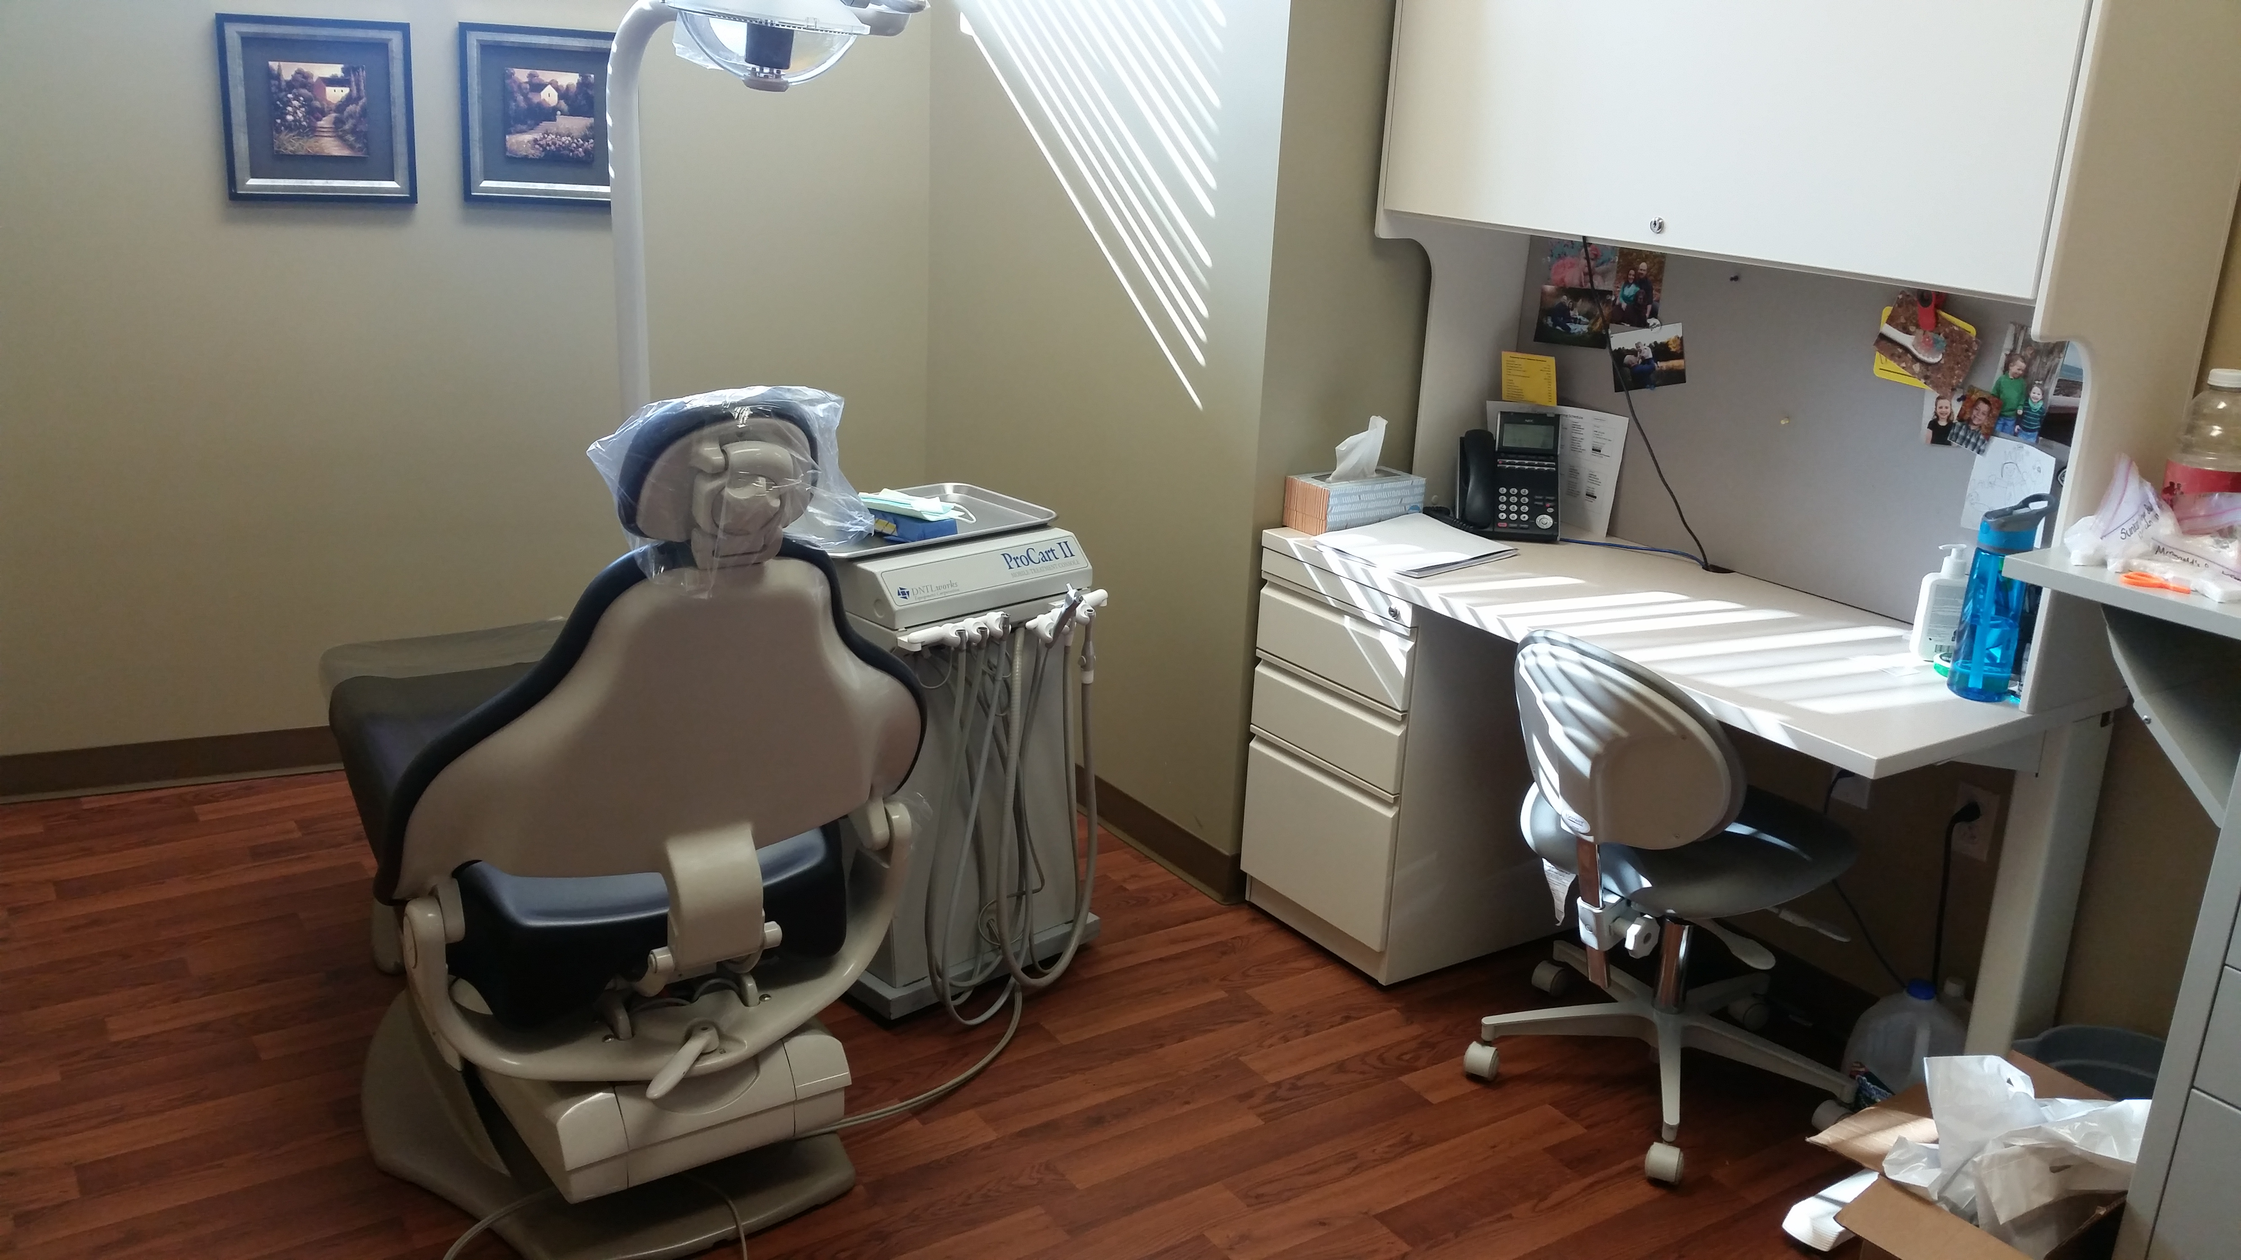
Physical Plant and Armamentarium
It is essential to dedicate space for the hygienist, e.g. a conference room or an exam room preferably with a sink.

Slide 11
Final Words from Project Coordinator
Quality Care:
Safe
Timely
Effective
Efficient
Equitable
Patient-Centered
Project Value:
Measurable Outcomes
Assessment
Prevention
Intervention
Referral to Dental Home
Patient Education

Slide 12
Time for Questions & Enjoy Your Tour!

Slide 13
Michigan Initiative for Maternal and Infant Oral Health
Subtitles
Grace Model for Pregnant Mothers
Muskegon Family Dental Coach Model
Authors
John Girdwood, MSA, PhD
Kevin Steely, DDS
Staci Hard, RDH
PUBLIC SESSION
9a: Welcome and Introductions of Key Partners
930a: Grace Health Model for Pregnant Mothers
10a: Tour of Grace Health
PROJECT PARTNER SESSION
1045a: Toolkit, Physical Plant, Armamentarium
Noon: Networking Lunch
1230p: Process and Workflow
130p: Dental Health Coach
2p: Coding, Billing, IT Support, and Data
230p: Research Project Calibration

Slide 14
1045a: Grace Model
Presenters
Kevin Steely, DDS
Brendan Collins, DO
Staci Hard, RDH
Tracie Hurst, RDH
Alisha Morris, MBA
Staci, Derrick (Muskegon), Tracie, and Kevin

Slide 15
Integrating the Hygienist into an OBGYN Clinic

Slide 16
Toolkit, Physical Plant, Armamentarium
Where should the room be in the clinic?
How does the room function in the OBGYN visit?

Slide 17
Equipment Checklist
Appropriate PPE such as gloves, masks, and eye protection
Appropriate barriers like head rest covers and light handle covers
Disinfectant spray and wipes
Appropriate disposables:
Suction tips
Gauze
Bibs
Prophy angles
Prophy paste
Floss
Cotton tip applicators
Disposable mirrors
Sealant materials
Etch
Sealant material
Micro brushes
Curing light
Fluoride varnish
Patient education material
Dental chair (preferably stationary, but portable would work)
Portable dental unit
Operator chair
Floor examination lamp
Operator headlamp
Desk/table
Closet/storage cart (for supplies)
8 exam cassettes containing:
Disposable mirrors
8 exam cassettes containing:
Mirror
Explorer
Perio probe
Cotton forceps
Air/water (unit-specific) syringe tip
4 prophy cassettes above containing:
Preferred scaling instruments

Slide 18
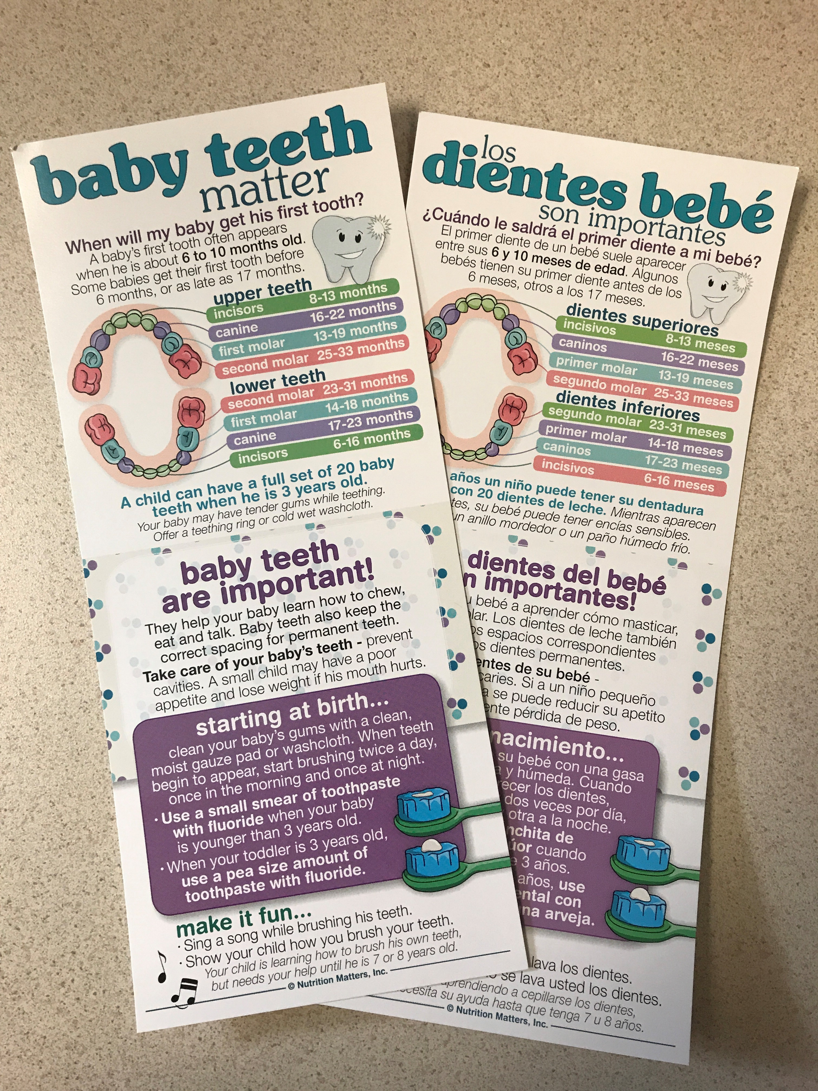
Patient Education and Material
Finger Brush

Slide 19
Value Stream
2 Healthy Mouths!
New mother and baby
Pregnant mother visits OBGYN for prenatal care
Prenatal oral health care provided

Slide 20
Time for Questions & Networking Lunch at Noon

Slide 21
1230a: Workflow
Presenters
Kevin Steely, DDS
Staci Hard, RDH
Tracie Hurst, RDH
John Girdwood, PhD
Joshua Thomson, PhD
Erin Relich, RDH, BSDH, MSA
Staci, Derrick (Muskegon), Tracie, and Kevin

Slide 22
1st Trimester Visit: Overview
Goals and tasks for initial visit:
Hygienist introduces herself and presents a brief overview of the program:
RDH should attempt to meet with patient early as possible
Meet with each patient when they present for their initial visit with the OB provider
Begin collecting data on the tracking sheet
Frequency of patient visits with the hygienist
Relevant discussion topics
Patient goal-setting and other oral health-related topics
Patients frequently ask questions the RDH can address
Build trust!

Slide 23
1st Trimester Visit: Value Stream Map
Hygienist schedules OB patient for visit during initial (1st) OB visit
Front desk checks patient in and attaches “DENTAL” card to encounters
Patient is seen by Care Coordinator
Patient sees OB provider in exam room
Care Coordinator brings patient to hygiene room
Hygienist walks patient to front desk for scheduling next OB appointment
Hygienist completes initial oral screening
Hygienist schedules appropriate appointments in dental department
Hygienist completes tracking form

Slide 24
2nd Trimester Visit: Overview
Goals and tasks for initial visit:
Hygienist reintroduces herself, continues tracking data, and addresses the following:
Occurs ≈24-26 wks gestation
Reorient patient to program
Address barriers like:
Fear
Lack of transportation
Lack of childcare for other children in the family
Inability to take off work
Overcome barriers!
Discuss food cariogenicity and dental caries disease progression
It is important to convey culturally-relevant and scientifically-correct information to the patient about their oral disease status

Slide 25
2nd Trimester Visit: Value Stream Map
Hygienist schedules OB patient for 2nd trimester visit (during 24-26-week OB recheck)
Front desk checks patient in and attaches “DENTAL” card to encounters
Patient is seen by Care Coordinator and taken to exam room
Patient sees OB provider in exam room
Care Coordinator brings patient to hygiene room
Hygienist walks patient to front desk for scheduling next OB appointment
Patient may either see OB provider or hygienist first
Hygienist completes tracking form (and refers to dental department if necessary)
Hygienist completes oral screening

Slide 26
3rd Trimester Visit: Overview
Goals and tasks for initial visit:
Hygienist reintroduces herself, continues tracking data, and addresses the following:
Occurs near the end of the pregnancy, usually around 36 weeks’ gestation
Ask if the patient has any concerns or pain
Start a conversation with visual aids about early childhood caries (ECC)
Differences between breastmilk and formula
Importance of brushing the teeth with fluoride toothpaste
Harm caused by sugary drinks
Frequency of dental visits
Streptococcus mutans bacterial transfer from caregiver to baby

Slide 27
3rd Trimester Visit: Value Stream Map
Hygienist schedules OB patient for 3rd trimester visit (during 34-36-week OB recheck)
Front desk checks patient in and attaches “DENTAL” card to encounters
Patient is seen by Care Coordinator and taken to exam room
Patient sees OB provider in exam room
Care Coordinator brings patient to hygiene room
Hygienist walks patient to front desk and then completes tracking form
Patient may either see OB provider or hygienist first
Hygienist educates patient on home care, diet, disease transmission, etc.
Hygienist completes oral screening and referral to dentist if needed

Slide 28
Post-Partum Visit: Overview
Goals and tasks for initial visit:
Hygienist reintroduces herself, continues tracking data, and addresses the following:
Can occur at any time after the baby is born
Prior to seeing the patient for postpartum visit, always verify:
baby is living
custody disposition for the baby
Visit should be a simple, straightforward, and brief appointment
Ensure the patient is not suffering any oral pain and address any dental concerns
Facilitate any appointments that need to be scheduled in the dental department
Other appropriate handouts to give the mother at this visit include, but not limited to:
“From Drool to School”
“Dental Care by Age 1”
with attached finger brush

Slide 29
Post-Partum Visit: Value Stream Map
Hygienist (or front desk) schedules OB patient for final visit (3-6 weeks post-partum)
Front desk checks patient in and attaches “DENTAL” card to encounters
Patient is seen by Care Coordinator and taken to exam room
Patient sees OB provider in exam room
Care Coordinator brings patient to hygiene room
Hygienist walks patient to front desk and then completes tracking form
Patient may either see OB provider or hygienist first
Hygienist educates patient on treatment plan, oral care for baby, etc.
Hygienist completes oral screening and referral to dentist if needed

Slide 30
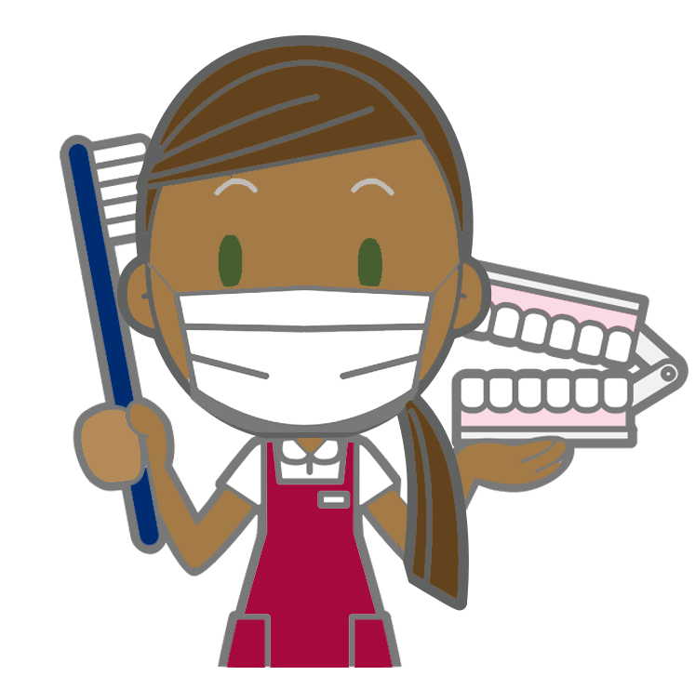
Remember…
Always keep the long term goal in mind
Life’s full of challenges
Promoting self-efficacy and empowering the patient can make a major impact. The Grace Health Model and RDH are the gateway to reducing barriers.

Slide 31
Setting Up a Centering Pregnancy Program for Pregnant Mothers

Slide 32
If your site offers “Centering Pregnancy”
An oral health screening during the centering session should mirror a regular 1st Trimester Grace Health Model visit. The RDH will:
Introduce herself and the Grace Health Model;
Gather info from the patient;
Complete the tracking form
Perform an intraoral screening;
Schedule any necessary dental appointments
For centering patients, postpartum visits should be specifically scheduled with patients to follow the program process and structure. The centering patients’ 6-week postpartum visit is a centering reunion so the RDH should facilitate an opportunity to see the patient and baby during the 3-week postpartum check.

Slide 33
130p The Muskegon Family Model: Care through Dental Coaching

Slide 34
Muskegon Rapid Improvement Event
Muskegon Family Care was a pilot site of the Michigan Caries Prevention Program (MCPP), a 3-year grant-funded effort to reduce Early Childhood Caries (ECC).
Muskegon Family Care physicians were trained how to provide oral health:
screening;
fluoride varnish;
patient education; and
referral to a dentist.
MFC physicians and staff completed a quality improvement effort to deliver:
efficient;
effective;
patient-centered care.
Two combined projects:
MCPP (occurs in PED clinic)
Colgate (link to dental clinic/staff)

Slide 35
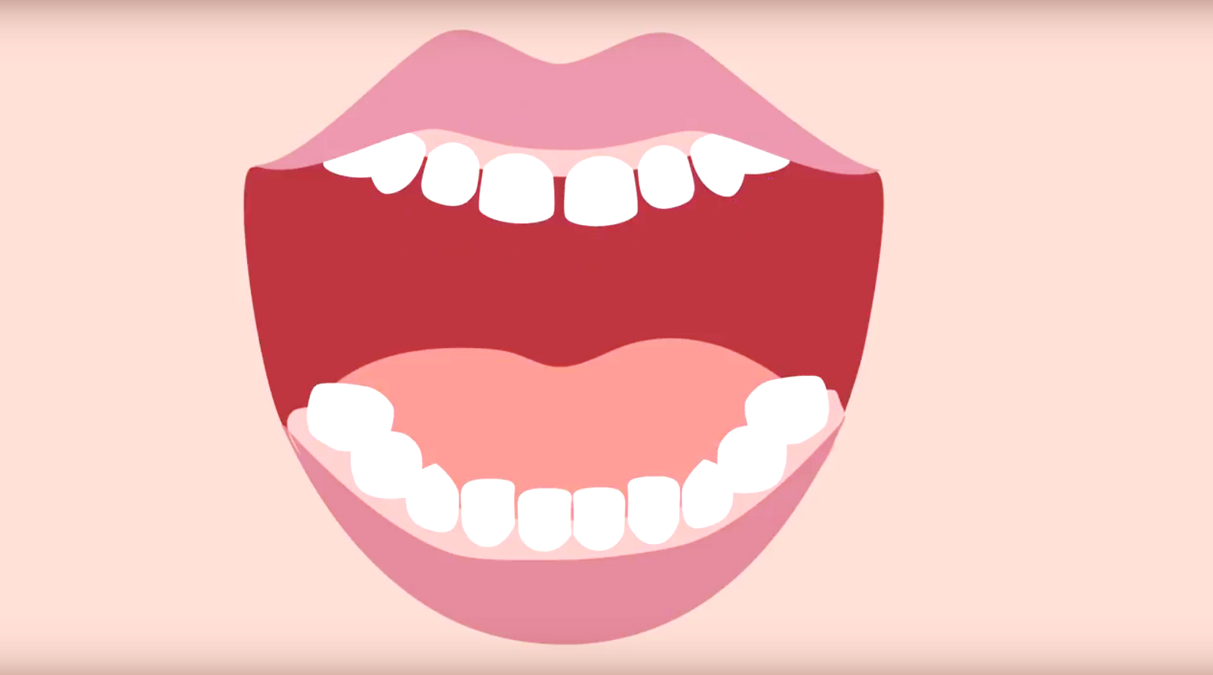
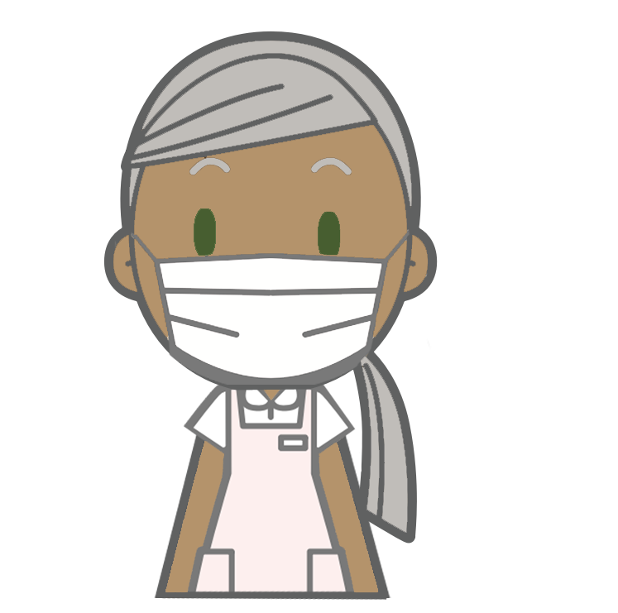
Muskegon Care Model Process
STUDENT/FACULTY CREATED ASSESSMENT TOOL
PEDIATRICIAN PROVIDES ORAL HEALTH CARE
STUDENT CREATED EDUCATION HANDOUT
STUDENT/COACH GETS DENTAL REFERRAL
Physician refers patient to dentist
or dental coach
Parent completes risk assessment
survey in waiting room before visit
Medical clinician applies fluoride varnish based on oral screening
Medical clinician educates patient based on needs

Slide 36
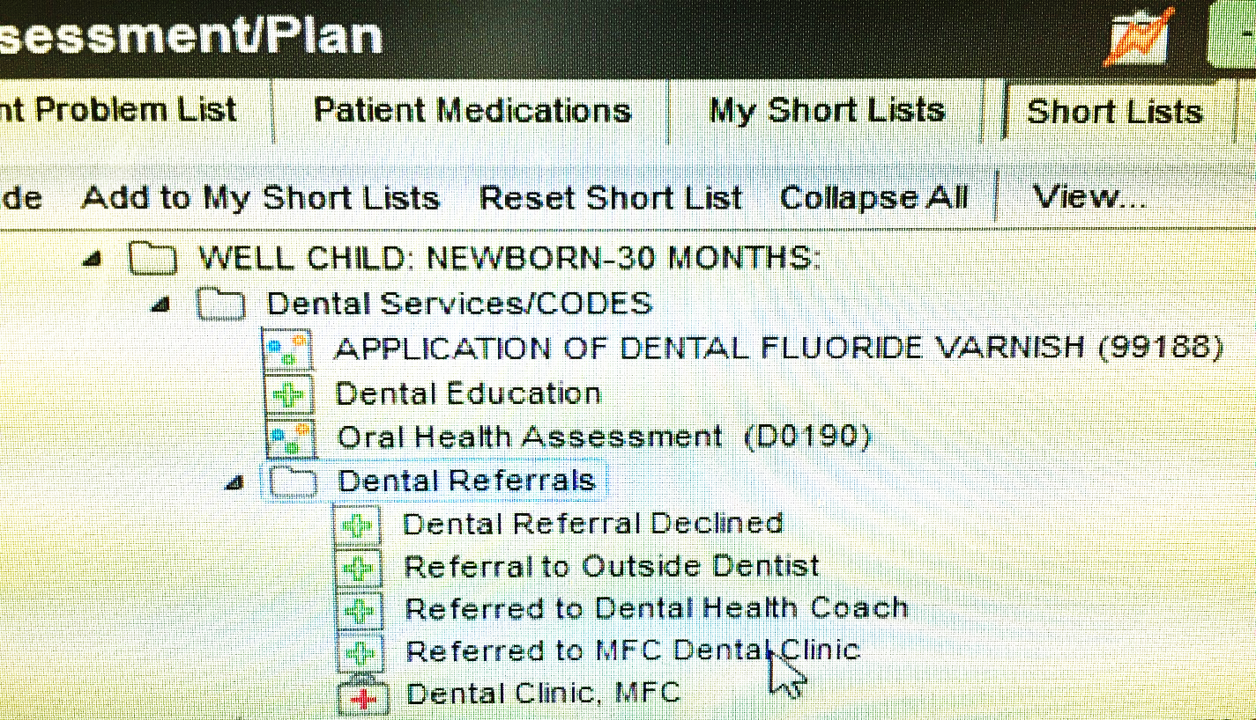
Armamentarium
Lobby (waiting room)
Pediatric medical clinic “as-is”
Fully stocked with fluoride varnish pre-packaged kits, toothpaste, and toothbrushes
Overhead PA system
Paper survey instrument with risk questionnaire
iPad for reporting survey results anonymously
Electronic Medical Records (EPIC EMR)

Slide 37
Dental Coach Program (Colgate)
6-month QI project separated into thirds, about 2 months each:
(i) adoption;
(ii) implementation;
(iii) sustainability
An IT staff member provided data on a weekly basis.
Two procedures, oral health screenings and fluoride varnish application, are billable medical interventions and can be measured by pulling data from the electronic health record system at the clinic.
Dental Coach intervention is not billable but would be if PA161 hygienist assessment!

Slide 38
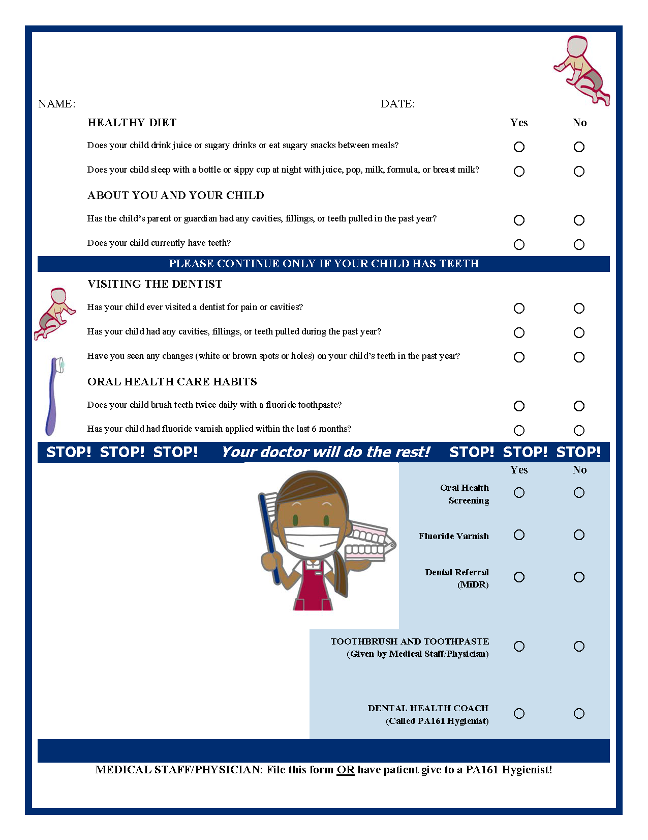
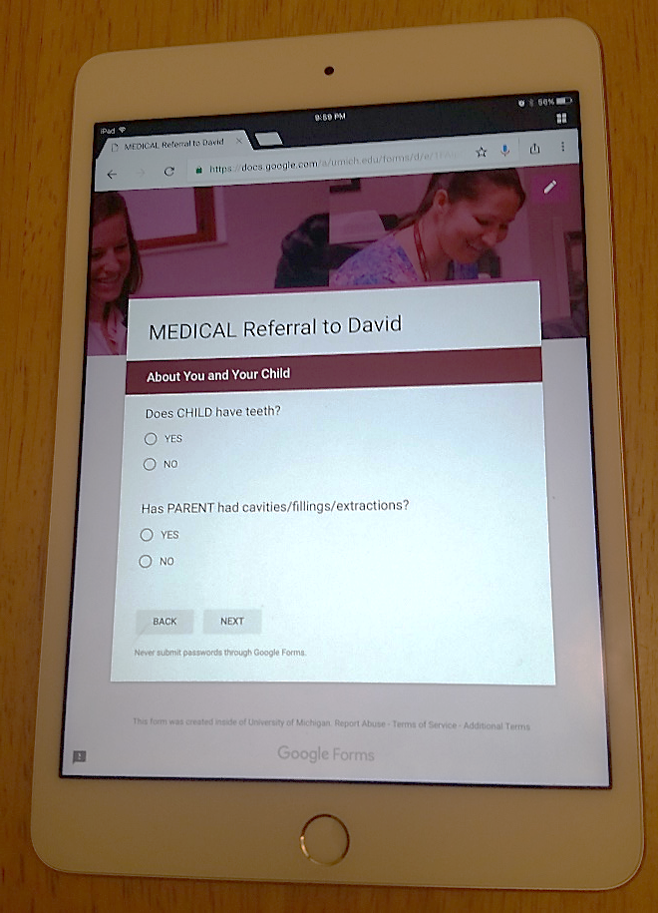
Project Instruments

Slide 39
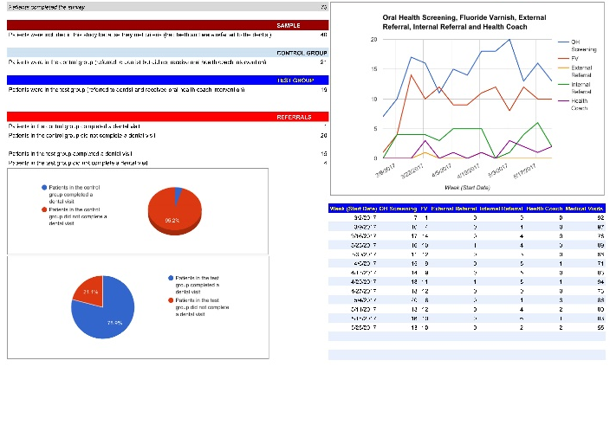
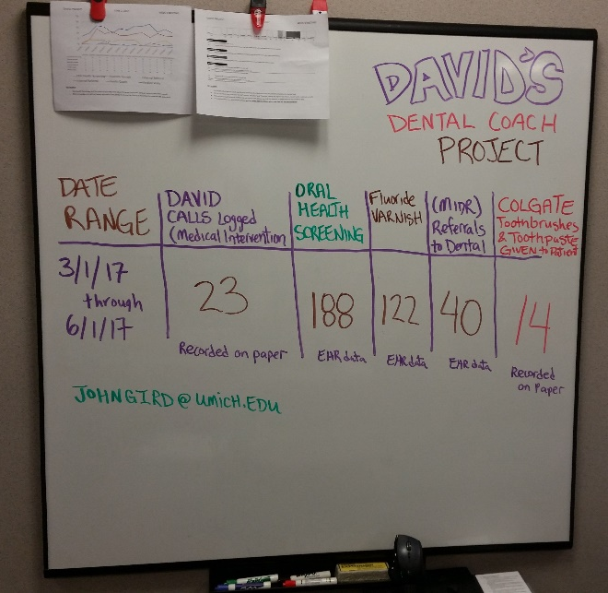
Reporting Tools and Initial Numbers
Week | Start OF Week | Oral Health Screening | Fluoride Varnish | External Referral | Internal Referral | Health Coach
1 | 3/3/2017 | 6 | 0
2 | 3/10/2017 | 11 | 6
3 | 3/17/2017 | 16 | 14
4 | 3/24/2017 | 20 | 14 |  |  | 3
5 | 3/31/2017 | 10 | 9 |  | 1
6 | 4/7/2017 | 15 | 11 |  | 1 | 1
7 | 4/14/2017 | 14 | 8
8 | 4/21/2017 | 16 | 10 | 1 | 2 | 1
9 | 4/28/2017 | 20 | 11
10 | 5/5/2017 | 18 | 10 |  | 1 | 3
11 | 5/12/2017 | 14 | 12 |  |  | 2
 |  | 160 | 105 | 1 | 5 | 10
Slow start is normal!

Slide 40
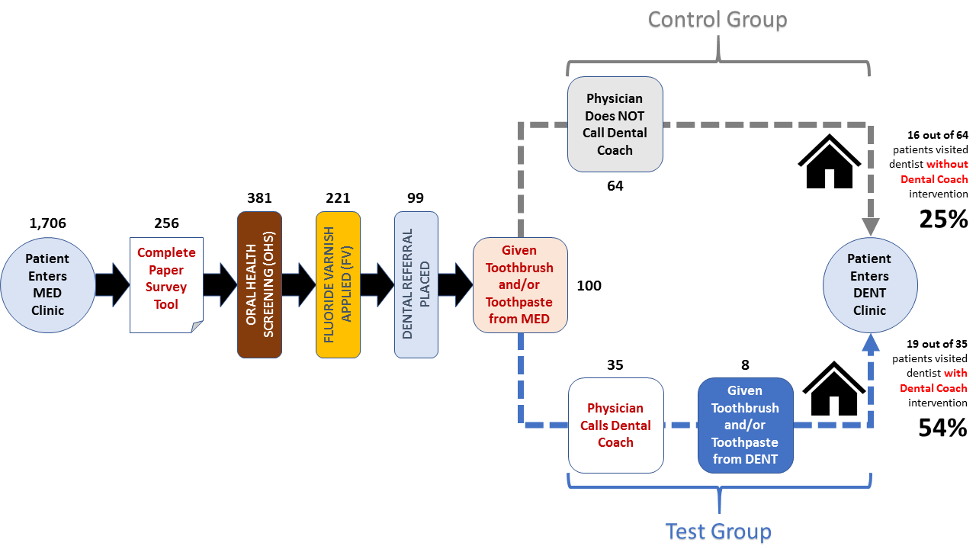
Value Stream Map
Great finish = Big impact!

Slide 41
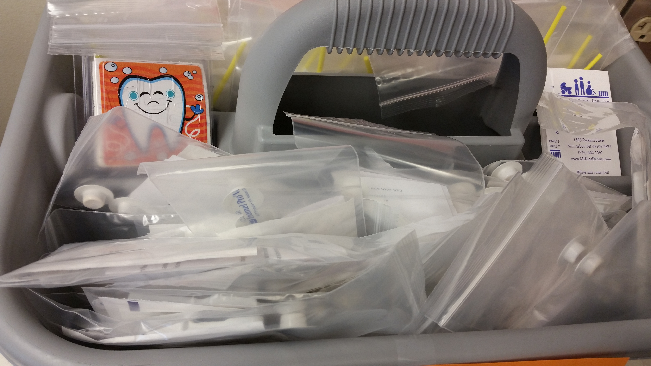
Pre-Packaged Kits

Slide 42
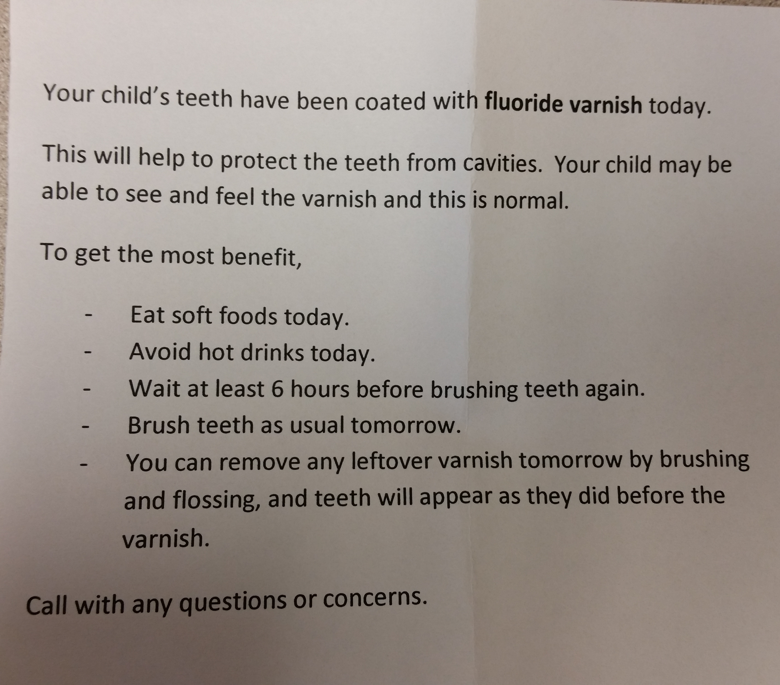
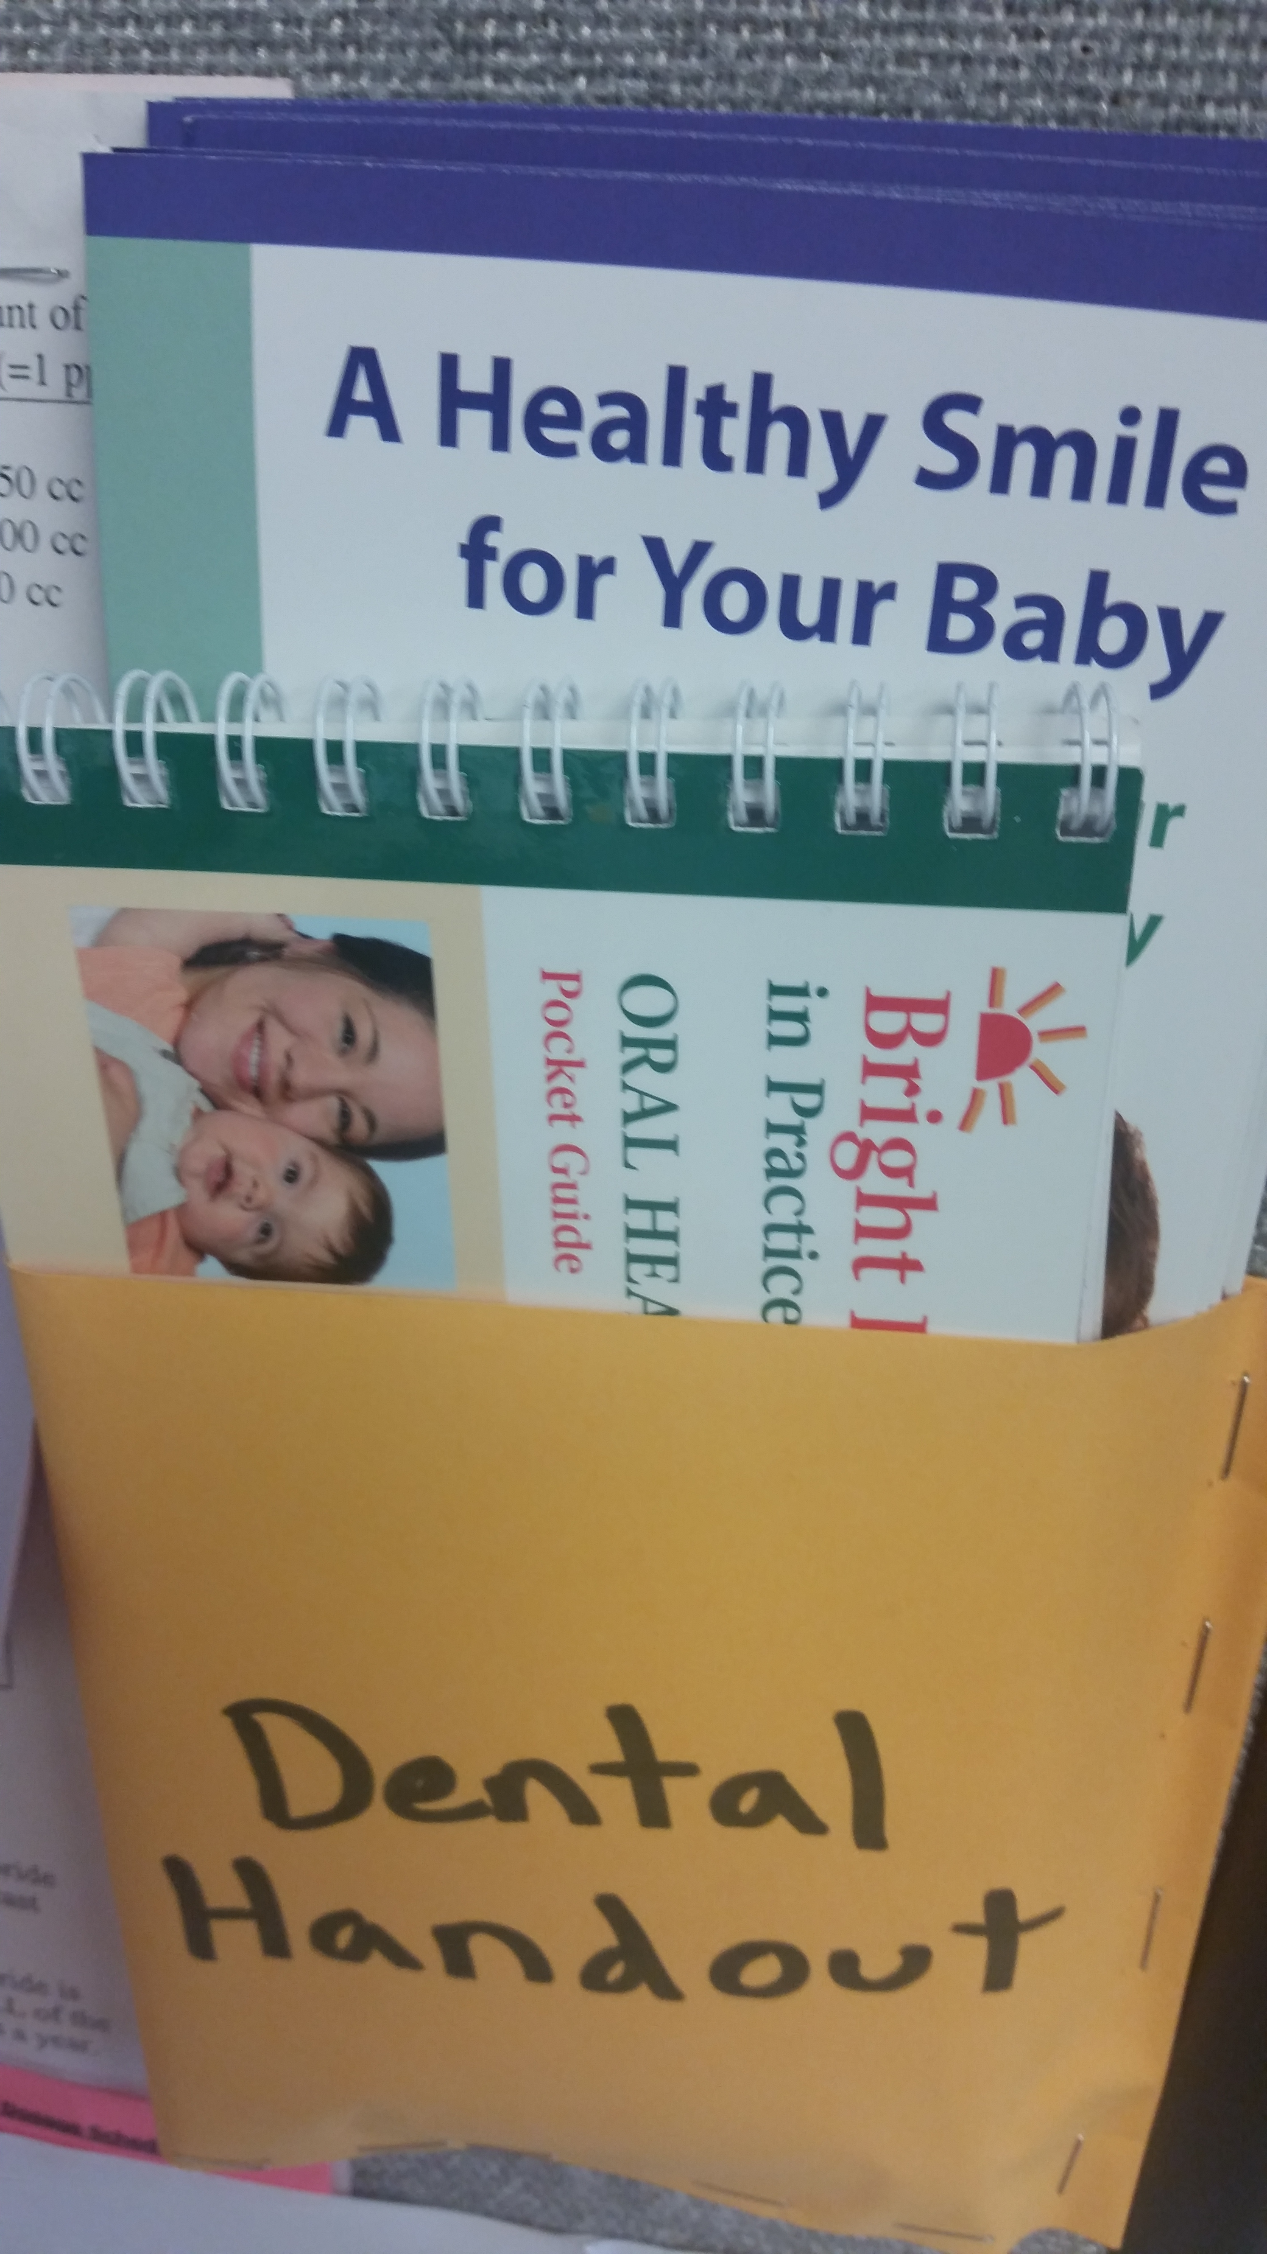
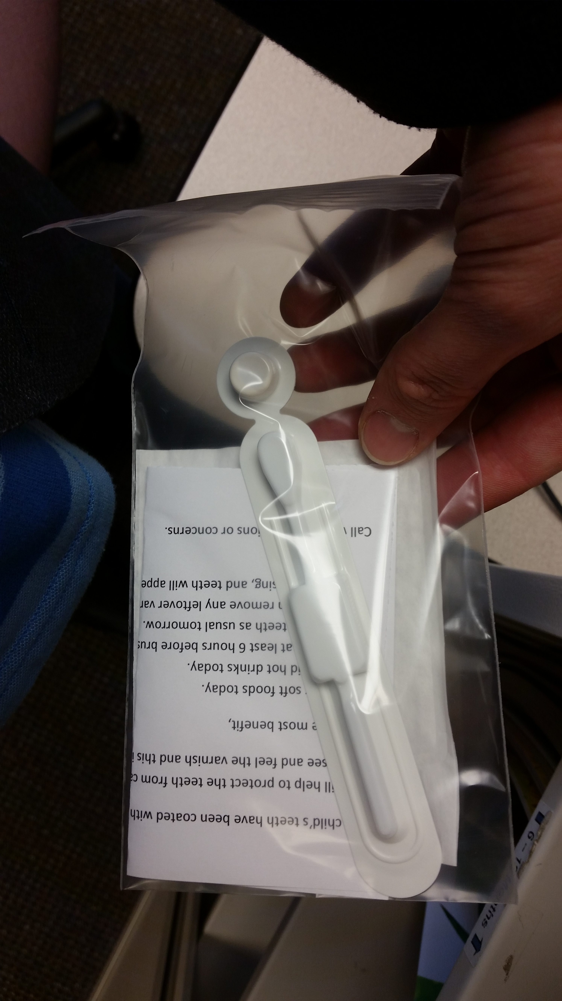
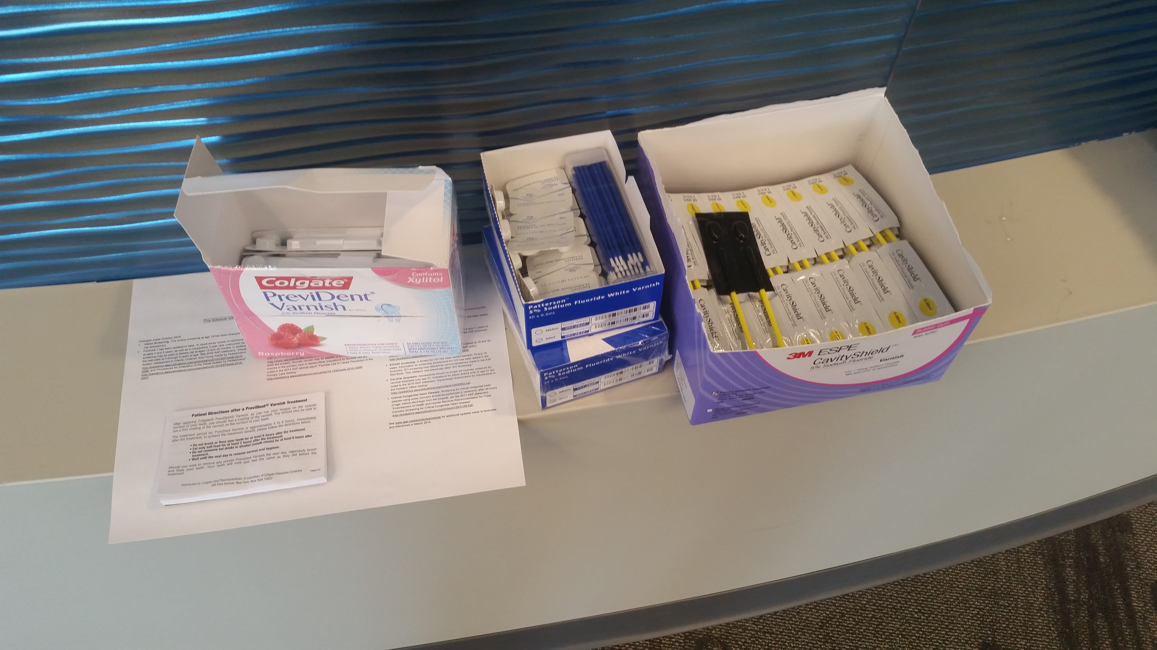
Resources Ready!

Slide 43
Coding, Billing, IT Support, and Data

Slide 44
IT Support and Training
IT must have capacity to provide daily reports containing relevant information which can be culled from EDR.
Grace Health IT provides a report every morning which lists the gestational status of every OB patient scheduled for care that same day.

Slide 45
230p Research Project Calibration

Slide 46
Steps for successful implementation
Overview of Project – 1st visit with the pregnant patient
Step #1 – Implementing the SCM test (Slides 37-38)
Step #4 – Discuss transmission of bacteria mother-to-child (Slide 42)
Step #7 – Check SCM test result (+ or -) and discuss with patient (Slide 43)
Provide handout to patient to take home with them on oral hygiene
Step #3 – Discuss importance of Oral Hygiene (Slides 40-41)
Step #2 – Explaining the role of plaque
(Slide 39)
Step #5 – Ask how cavity causing bacteria are passed to a child (Slide 42)
Step #6 – Patient education of how to minimize transmission of bacteria (Slide 42)

Slide 47
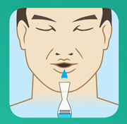
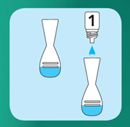
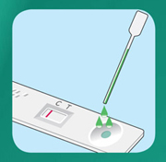
Implementing SCM test with patient
Test takes approximately 15 minutes to process.
1
Have patient chew gum for 30 seconds
2
Patient is instructed to expectorate into a sterile cup
3
Solution is added and test begins
4
OHI is reviewed with the patient while the test processes
5

Slide 48
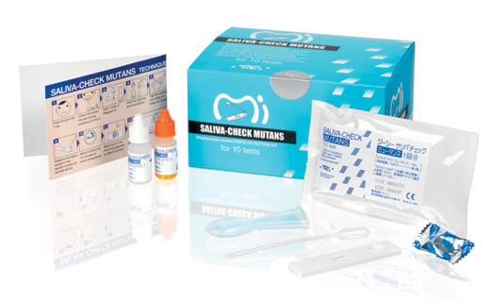
Saliva-Check Mutans Test
After 15 minutes:
Positive Result >500,000CFU/mL S. mutans
Negative Result <500,000CFU/mL S. mutans
https://www.youtube.com/watch?v=TqaM2XI-qbE
3:20 – 5:03

Slide 49
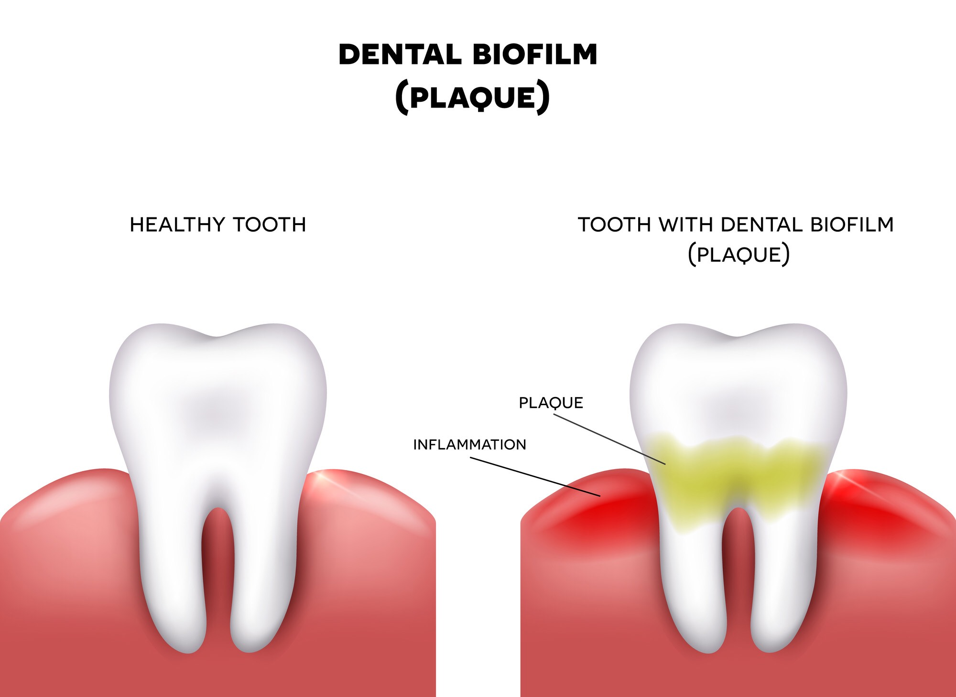
Healthy teeth versus teeth with plaque
Brushing, flossing & use of mouth rinse 2 times daily
Lack/infrequency of daily brushing, flossing and mouth rinse

Slide 50
Please read and discuss this explanation on oral hygiene best practices with to the patient
Oral hygiene is the practice of keeping one's mouth clean and free of disease and other problems by regular brushing and cleaning between the teeth. It is important that oral hygiene be carried out on a regular basis to enable prevention of dental disease. The most common types of dental disease are tooth decay and gum diseases, including gingivitis, and periodontitis. Regular brushing consists of brushing twice a day after breakfast and before going to bed. Cleaning between the teeth is called interdental cleaning and is as important as tooth brushing. This is because a toothbrush cannot reach between the teeth and therefore, only cleans 50% of the surfaces. There are many tools to clean between the teeth, including floss and interdental brushes. It is up to each individual to choose which tool he or she prefers to use. Antibacterial mouth rinses can also be used to keep breath fresh and kill the bacteria in the mouth that causes oral diseases.

Slide 51
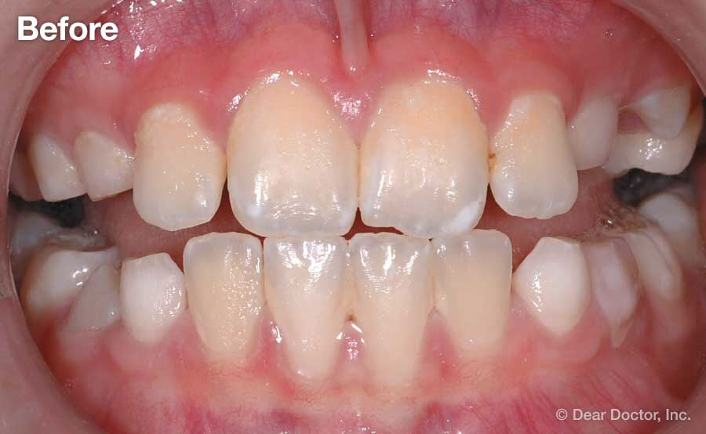
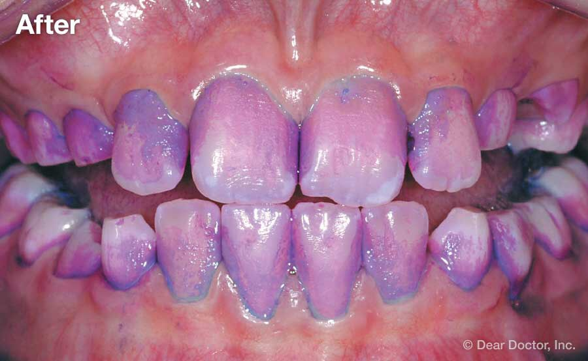
BEFORE & AFTER disclosing solution/colored dye applied
Plaque isn’t always easy to detect as it usually blends in with the tooth
By looking under a microscope or by using colored disclosing solution/dyes, plaque is quite noticeable!
Plaque returns rapidly (within 8-12 hours), so frequent removal by brushing, flossing and mouth rinse is key!

Slide 52
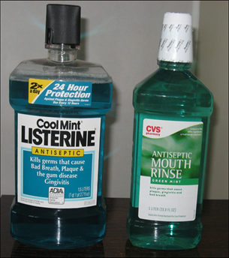
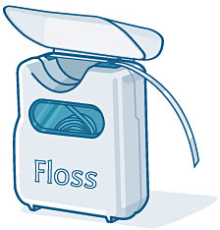
How can cavity causing bacteria be transferred from a mother to her child?
How can mom reduce transmission of bacteria to child?

Slide 53
SCM test results

Slide 54
Time for Questions & Final Words from Project Team

Slide 55
Session Conclusion
Your #1 Priority is ALWAYS the PATIENT!
We focus on the both mother and child!
This is a life course approach to reducing caries and improving oral health outcomes!
Three-prong approach:
Care Delivery
Patient-Centered
Provision/Workflow Monitoring
Drop the right codes
Billing and reimbursement
Bacteria Research
Pre- and Post!

Slide 56
MORE Years of Patient-Centered Care
Launched 7/14/2014
Blue Cross Blue Shield of MI initial funding
Now, funded by State of Michigan through 09/30/2018
1 of 5 pilot programs
Now, 6 pilot programs statewide
1st Year ≈ 300 women served
300 x 6 sites = 1,800 Estimate 2018
ALWAYS PATIENT-CENTERED
Mother Rosa and her child Arturo
Photo: (left to right) Jessica Southerland, RDH; Rosa Cecilia Lara-Rives and Staci Hard, RDH
http://www.gracehealthmi.org/uncategorized/1st-patient-complete-oral-health-program/

Slide 57
Thank You and Drive Home Safely!

